Slide 1
SWEN - Daily Food Logger
Phase I
Esmari Louw, Dora Pehar-Ljoljic, Natalie Frank

Slide 2
Overview:
Goal: Build a system to help users log their food intake, manage calorie limits, and track daily progress.
Key Features:
Add food items (basic food or recipes).
View daily log of food intake.
Set and track calorie limits and weight
Display through GUI for users to view.

Slide 3
Features:
Core Features Implemented
Food Collection:
Users can add basic food items and recipes.
Food data is saved in foods.csv
Daily Log:
Log food consumption for each day.
Adjust and track daily calorie limits and weight in log.csv.
User Interaction:
Command-line interface to interact with the program.
Menu-driven options for logging and viewing data

Slide 4
Architecture:
User Input → Add food item or log food.
Food Collection → Food data stored in foods.csv
Daily Log → Logs saved in log.csv
GUI Interaction → User interacts through graphical buttons, dropdowns, and fields.
Data Flow:
Class Overview:
Food (abstract class): Base class for food items and recipes.
FoodCollection: Stores and manages food items; handles adding food and saving to foods.csv.
Recipe: Represents food recipes composed of multiple ingredients.
DailyLog: Manages daily logs for food consumption, calorie limits, and weight tracking.
GUI: Graphical user interface that allows the user to interact with the system more intuitively.

Slide 5
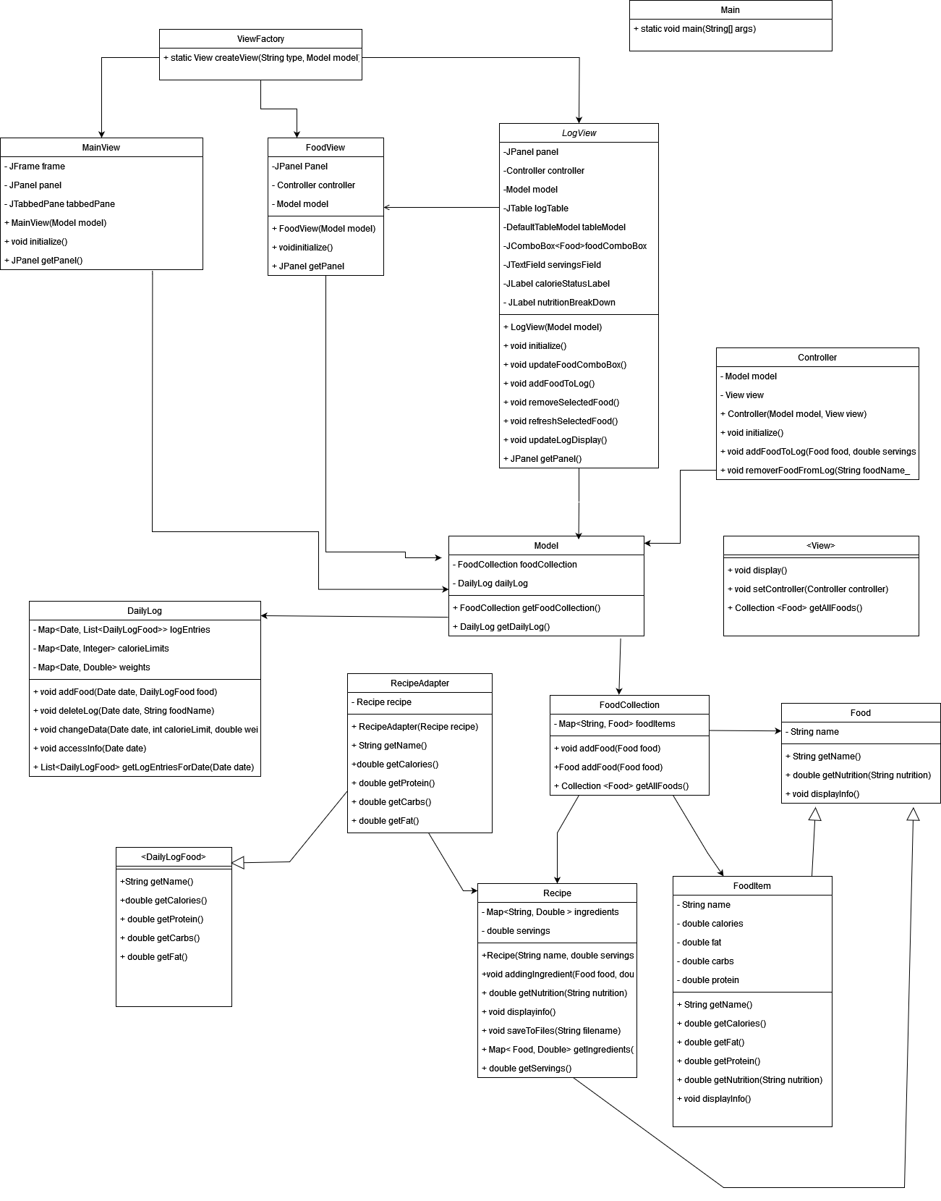
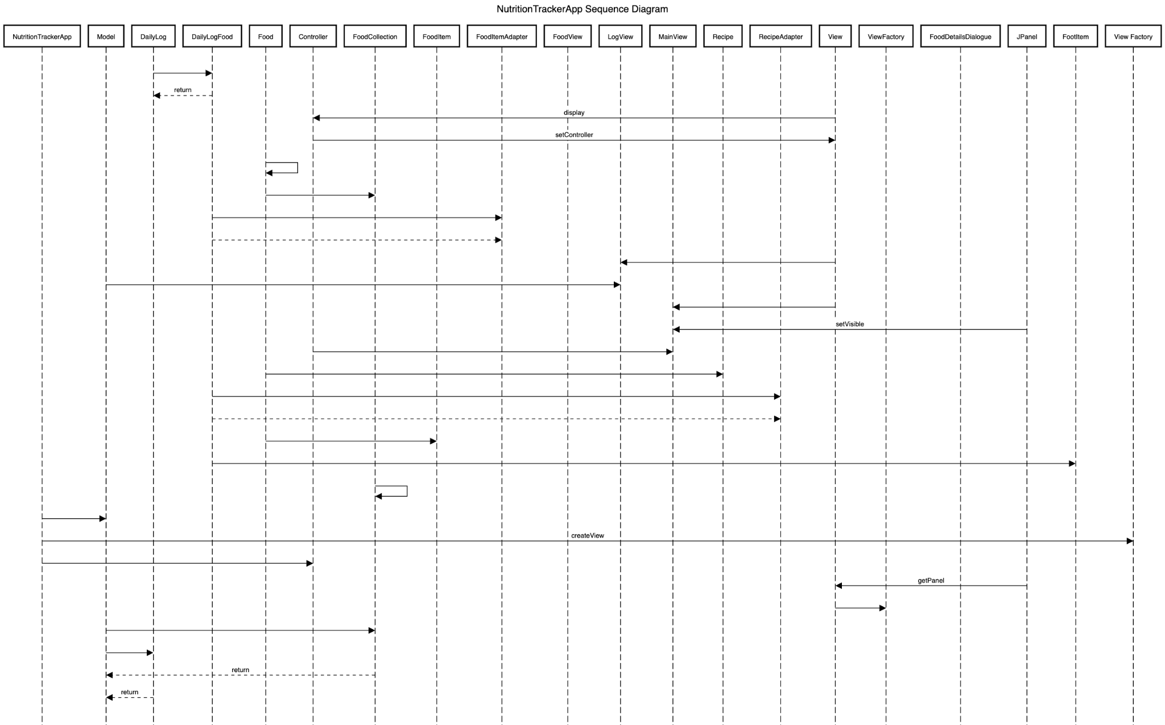
UML -CLASS DIAGRAM
SEQUENCE DIAGRAM
URL

Slide 6
Design Patterns Used:
Composite Pattern : The Recipe class acts as a composite, and can contain Food objects (FoodItem and Recipes)
2. Adapter Pattern: To allow Recipe objects and FoodItem objects to be treated in the same way, even though they have different interfaces.
3. MVC Pattern: Separates the application into three components:
Model: Model, FoodCollection, DailyLog classes handle data and business logic
View: View interface and implementations (MainView, FoodView, LogView) handle UI presentation
Controller: Controller class mediates between Model and View
4. Factory Method pattern: Creates different view types, and is really useful for debugging

Slide 7
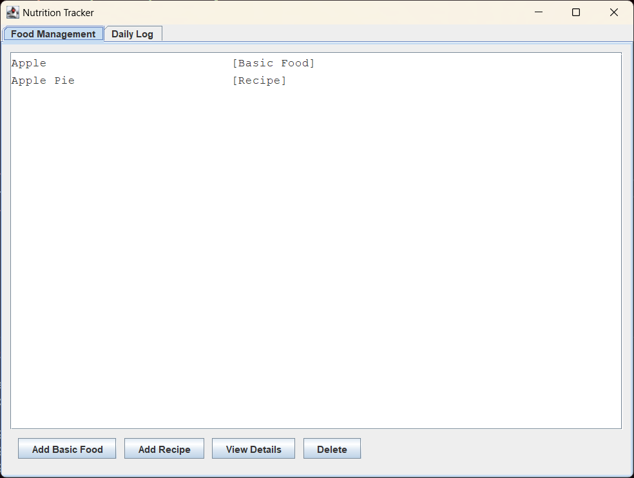
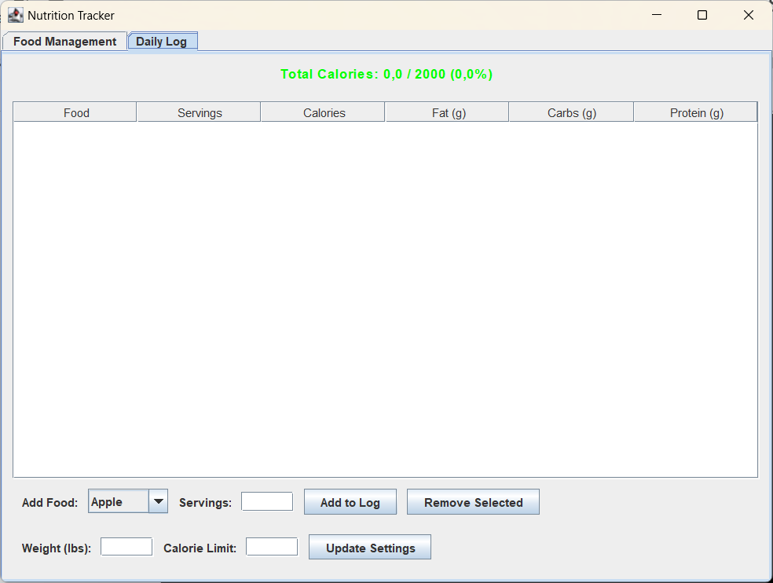
GUI Implementation

Slide 8
Challenges:
Basic Understanding Of Project:
Brainstorming ideas as a team for project class layouts and
Overall implementation of functions
Handling CSV File I/O:
Preventing data duplication and maintaining data integrity
Having proper reading and writing CSV files for log.csv and recipe.csv
User Input Handling:
Managing case-insensitive food names
Validating food items and handling errors when food isn’t found
Complexity of Recipes:
Combining multiple food items to create a ‘recipe’.
Date and Weight of recipes
GUI Implementation:
Figuring out how to implement the design
Fixing the bugs, and changing the code for the model part of the GUI

Slide 9
Conclusion
Phase I Accomplishments:
Successfully implemented core features: food logging, calorie limit management, weight tracking, and a GUI for easier interaction.
Data is saved in CSV files, and the system allows users to track and update their daily logs efficiently.
Next Steps:
Implement Phase II improvements based on feedback.
Add exercise tracking, calorie goals, and weight logging for better user monitoring.
Ensure data persistence in CSV files (foods, exercises, logs).
Implement bar chart visualization for nutrient breakdown.
Improve Composite Pattern for recipes and strengthen MVC design

Slide 10
Thank you!
SWEN PROJECT: Phase 1 Esmari Louw, Dora Phear-Ljoljic, Natalie Frank
02/04/2025

